Slide 1

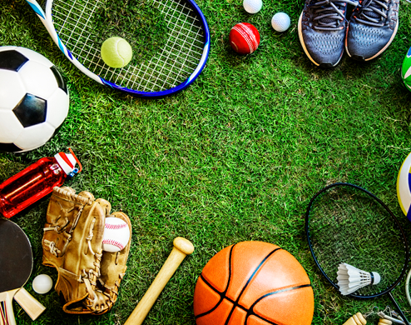
Sports & Well-being
Indian Institute of Technology-Kharagpur
Physical, Psychological & Social
Manas K Mandal

Slide 2
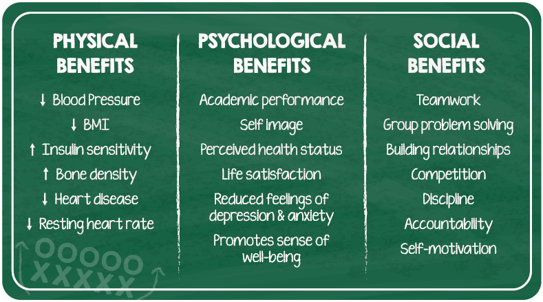
Dimensions of well-being
Indian Institute of Technology-Kharagpur
Physical well-being: Ability to maintain a healthy quality of life to get through daily activities
Social well-being: Ability to connect with others & maintain positive relationships
Subjective well-being: Ability to understand ourselves & cope with challenges

Slide 3
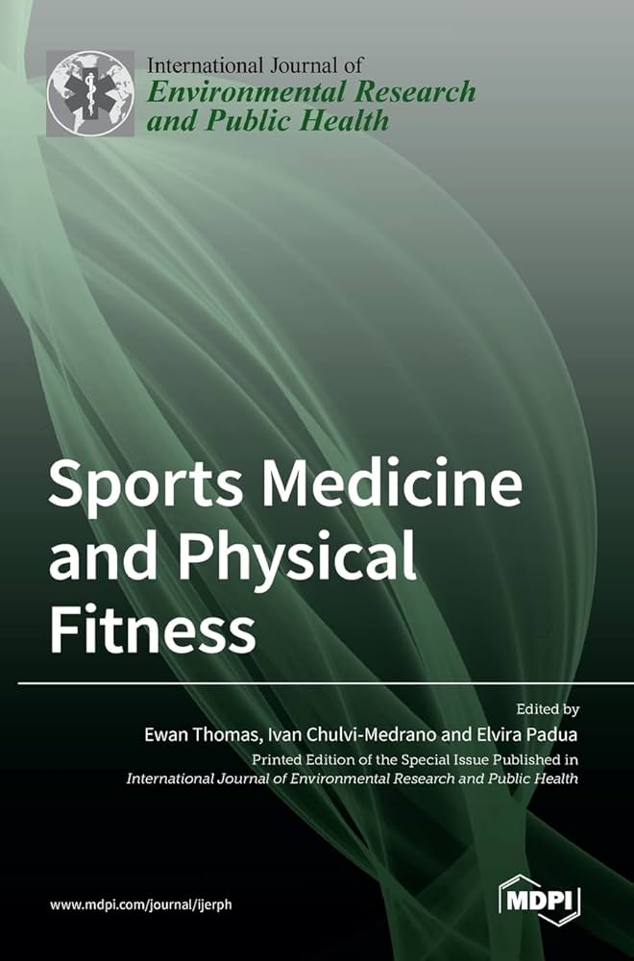
Physical exercise: Some evidence
Indian Institute of Technology-Kharagpur
Physically active persons are better equipped to fight stress (Journal of Sports Medicine & Physical Fitness)
Effects of physical activity (like exercise) lasts longer than anti-depressants (European archives of Medicine & Physical Fitness, 2014)
Physical activity (like exercise) releases ‘happy’ brain chemicals like endorphins & monoamines (Brain Sciences, 2013)
Body shapes raise our self-esteem & happiness, though not a necessary cause

Slide 4
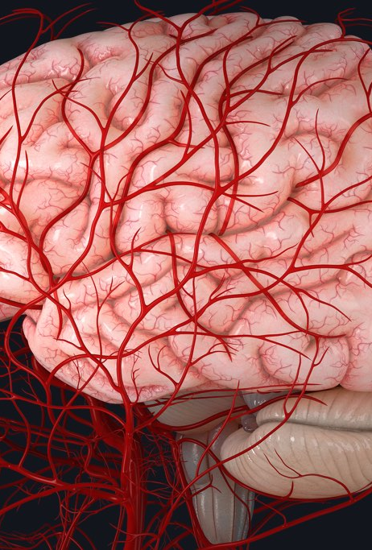
Brain & Physical fitness
Indian Institute of Technology-Kharagpur
Exercise increases blood flow to the cortex of the brain; attribute to brain growth factor
Regular physical activity may reduce norepinephrine (a vasoconstrictor which reduces blood flow to the brain)
Exercise positively impacts levels of serotonin, a chemical that stimulates the neurotransmitter norepinephrine, which improves mood
Physical activity releases endorphins, the body’s natural “happy chemicals,” and reduces levels of the stress hormone cortisol.

Slide 5
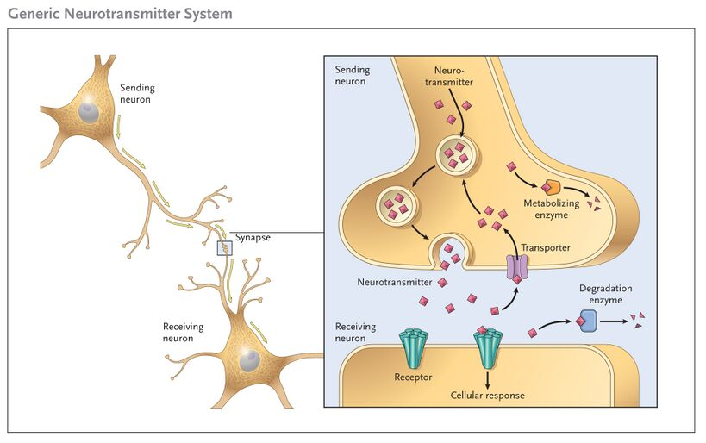
Physical exercise & brain chemicals
Indian Institute of Technology-Kharagpur
Endorphin [The pain killer] : manufactured at several locations in the brain; inhibits the transmission & perception of pain; vigorous exercise produce endorphin
01
Dopamine [The rewarding chemical] is associated with reward & motivation; made up of several excitatory pathways in the brain
02
Serotonin [The mood stabilizer] is mostly manufactured & stored in GI tract; helps control mood, appetite, sleep; deficits lead to clinical depression;
03

Slide 6
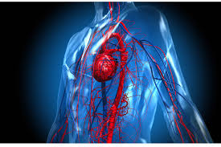
Effects of physical activity on the cardiovascular system
Indian Institute of Technology-Kharagpur
Short Term Effects
Faster heart contractions leading to increased heart rate and increased circulation, which gets oxygenated blood to your muscles quicker
Forceful heart contractions lead to a greater amount of blood being pumped throughout the body
Long Term Effects
The heart and lungs become more efficient
Decreased resting heart rate
Improved ability to draw in deeper and longer breaths
Reduced risk of heart disease

Slide 7
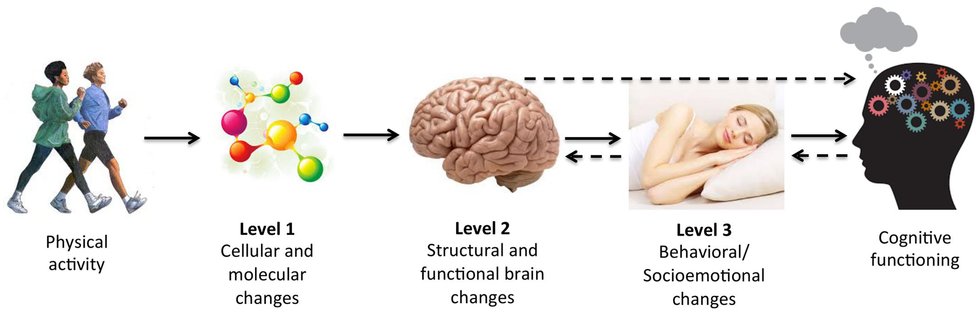
Sports & Psychological well-being
Indian Institute of Technology-Kharagpur
Sports are associated with lower rates of stress, anxiety, depression, and suicidal behavior
Participation in team sports reduces the risk of substance abuse and other reckless behaviors
Team sports enhance resilience, empathy, confidence and empowerment
Increase executive functioning, creativity, cognitive development, and self-regulation
Sleep improves which is essential for mental health

Slide 8

Indian Institute of Technology-Kharagpur
Cognitive processing - stages
Sensation
Acceptance of energy
Perception
Energy is interpreted in perception
Registration
Attention
Perception is guided by attention
Memory
Attended matter is stored
Cognition
Processing
Learning
Stored memory helps learn
Problem solving
Learning helps solve problems
Intelligence
Problem solving depends on intelligence
Retrieval
Emotion
Intelligence is moderated by emotion

Slide 9
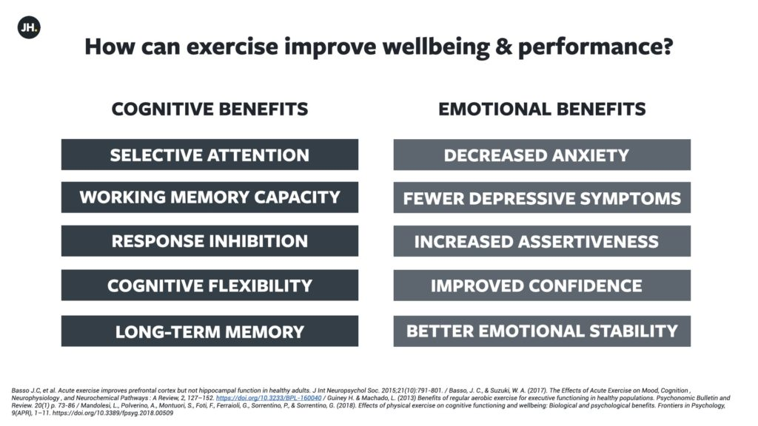
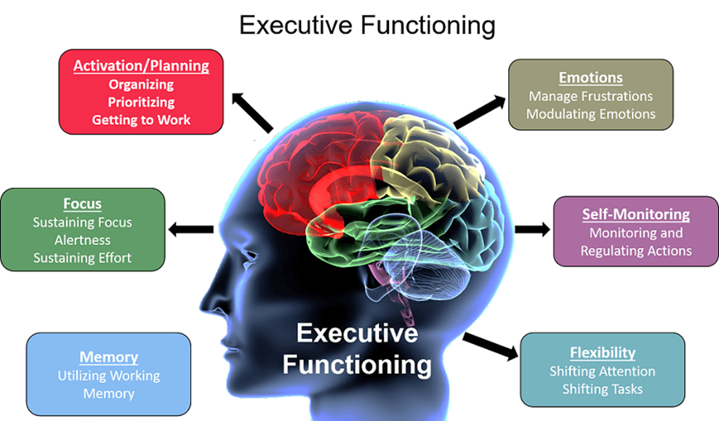
Cognitive benefits of physical exercise
Indian Institute of Technology-Kharagpur

Slide 10
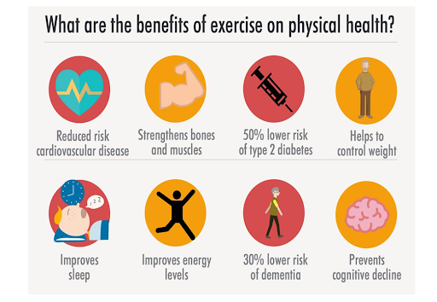
Benefits of sports & physical activities
Indian Institute of Technology-Kharagpur
Improve your memory & brain function (all ages)
Protect against many chronic diseases
Greater flexibility & strength
Lower blood pressure & lower cholesterol
Improve your quality of sleep
Lower anxiety & hostility
Greater optimism & resilience
Greater mobility & longevity

Slide 11
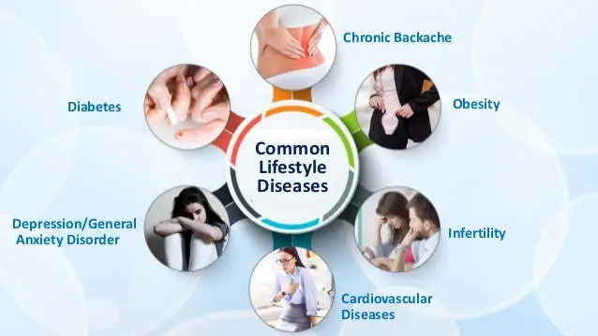
Some questions
Indian Institute of Technology-Kharagpur
Why do people indulge in self-defeating behavior & develop life-style disease?
How is risk-to-life communicated? Why is it essential?

Slide 12

Why do people develop Life-style diseases?
Indian Institute of Technology-Kharagpur
Risk perception
Impulse control
Health belief
Paradoxical pleasure
Behavior Choice
Optimism bias

Slide 13
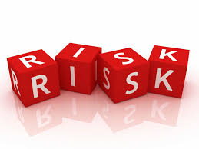
Indian Institute of Technology-Kharagpur
How risk to life is communicated?
Risk communication (emphasis on threat)
Risk perception (errors due to avoidance)
Life-style decisions (invariant to risk perception)
Risk projection (excessive threat reduce caution)
Risk denial (dangerous future but instant pleasure)

Slide 14
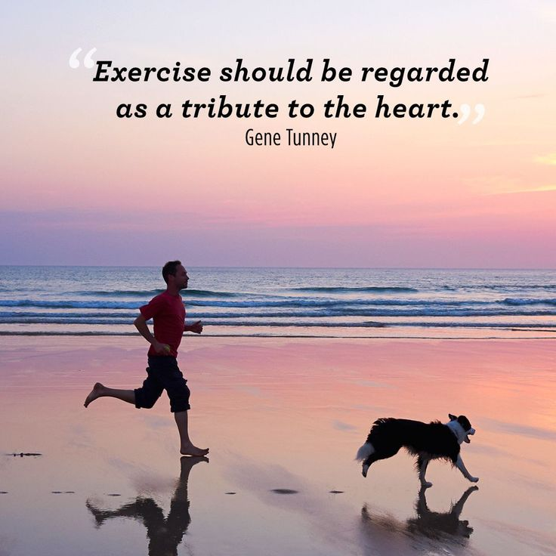
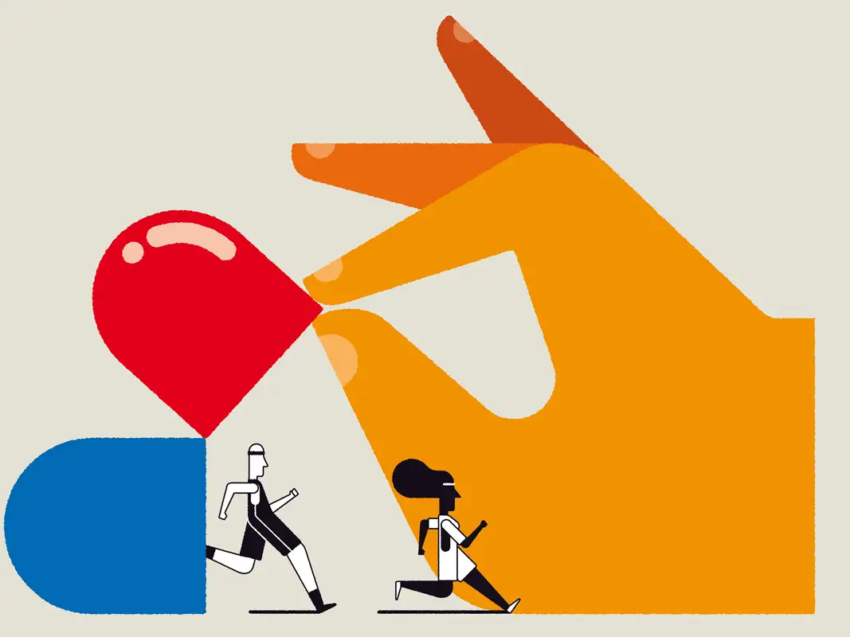
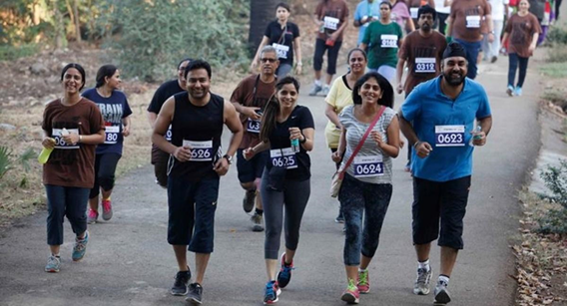
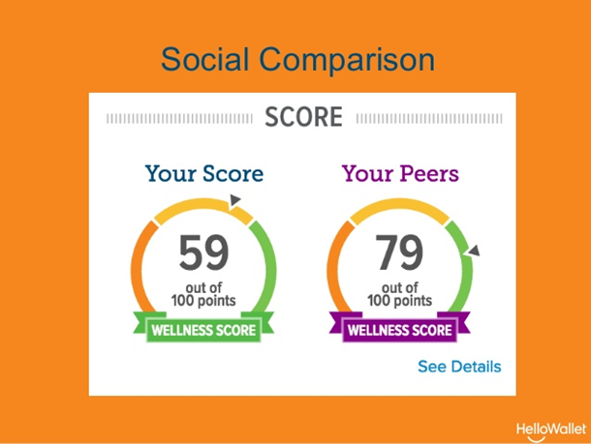
Message types
Indian Institute of Technology-Kharagpur
Direct messages
Cryptic messages
Inclusive messages
Nudge messages
Let’s plant a hope for tomorrow
Use your brain, not the drain
Reflect your hope, not fears
???

Slide 15
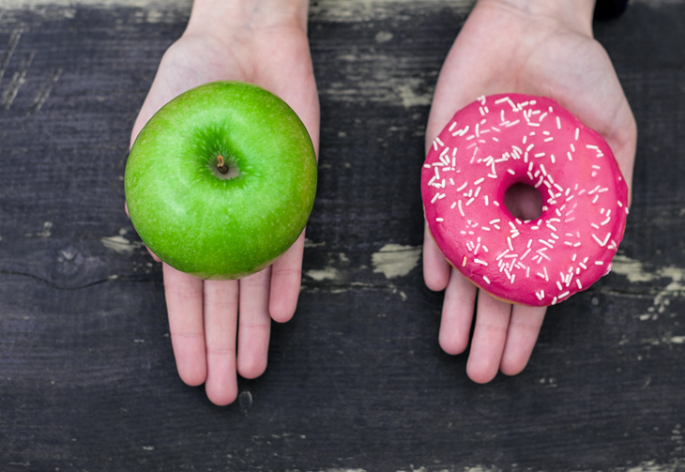
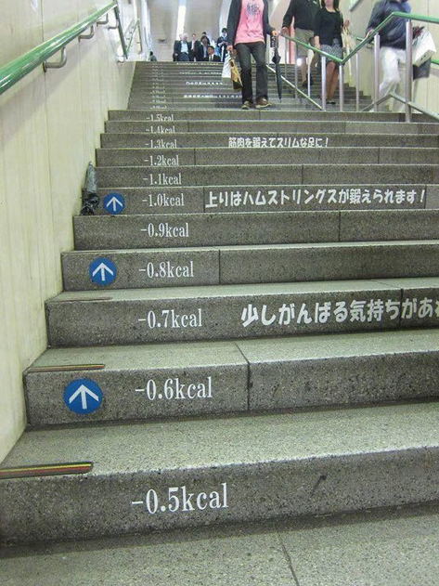
Indian Institute of Technology-Kharagpur
Nudge (Thaler & Sunstein, 2016)
It’s about steering people towards better decisions, but leaving them free to choose
It’s about influencing behavior by indirect suggestion to a given direction without removing option
Low-cost, behaviourally-informed, choice-
preserving solutions

